Slide 1
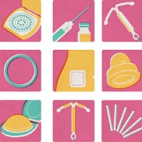
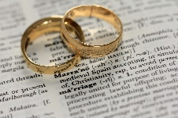
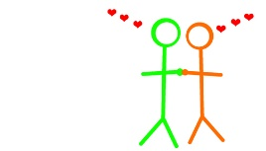
Relationship and Sex Education at St John Fisher Catholic High School
Parenting (R4, 25, 33)
Internet Safety Assembly
Life After St John Fisher
College or Apprenticeships and the start of being a young adult
Sexting and the Law R26, 27
The different forms of contraception. (R23, H27, H28, H29)
Legal Status of Marriage (R4, 25, 33)
Stalking and Harassment ( R3, 5, 7, 16)
Internet Safety Assembly
Year 11
Diversity and racism assembly
Year 10
Peer pressure and how to overcome it. (R35, 36, 37, 38).
Risk and STIs
(H27, R18).
Long Term Commitments (R1, 4)
Diversity and racism assembly
Contraception – planning means choices (R15,17,21,22,28,30)
Risk & consent
Disability Discrimination
R3
(R1,7,8,15,16,21,30
Internet Safety Assembly
Year 9
LGBTQAI
R1, 3,4,5
Internet Safety Assembly
Relationships (R1,8,9,11,12,29)
STIs
Negative Relationships. Bullying Assembly
Negative Relationships. Bullying Assembly
Racism And why it is wrong.
R3, R38, 39, 41)
R7,21,22,23,26,29)
Online Grooming
Internet Safety Assembly
How does the media show prejudice towards teens?
R39, 40, 41
Puberty (R22,24)
Year 8
Negative Relationships. Bullying Assembly
Sexting and the Law R26, 27
Risk and young people (R44)
Prejudice and discrimination (R39, 41)
Maintaining Genuine Friendships and avoiding toxic ones (R13,14,19,21)
Year 7
Online Bullying
R37, 38, 39, 40, 41)
Mutual Respect and tolerance (R39, 40, 41)
Numbers in brackets refer to PSHE Assoc. Mapping of RSE

